Slide 1

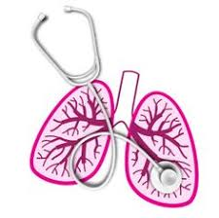
University of Basrah Al-Zahraa Medical College
Ministry of Higher Education and Scientific Research
Academic year 2021-2022 - S4
Respiratory system module (RS)
Session: 2 Lecture: 1
Introduction to Respiratory System
Module staff:
Dr. Nehaya Mnahi
[module leader]
Dr. Ahmed Badr
Dr. Nawal Mustafa
Dr.Firas Mohamed
Dr. Ahmed Jafer
Dr.Karam Basil
Dr. Amer Qasim
Dr. Ahmed Qassim
Gannon’s Review of Medical Physiology by Barrett.
Guyton and Hall physiology text book 2016, Vander s Human physiology 13 ed.
For more detailed instructions, any question, or you have a case you need help in,
please post to the group of session. Images are under Creative Commons Distribution

Slide 2
University of Basrah Al-zahraa medical college
Ministry of Higher Education and Scientific Research
Learning Objectives:
1- Explain the broad functions of the respiratory system in health.
2- Define the terms upper & lower respiratory tract.
3- State Boyles law, Charles law, the Universal Gas Law. Define the terms 'partial pressure', 'vapour pressure', 'saturated vapour pressure', 'tension' and 'content' of gas in a liquid.
4- Define the terms, 'tidal volume', 'respiratory rate' and 'pulmonary ventilation rate.'

Slide 3
University of Basrah Al-zahraa medical college
Ministry of Higher Education and Scientific Research
Functions of the respiratory system
A- Respiratory functions:
LO1
Respiration: is the collective process of :
Inhalation O2 from the environment
O2 absorption by red blood cells
Transport to the tissues in exchange with CO2
Exhale CO2 back to the atmosphere.

Slide 4
University of Basrah Al-zahraa medical college
Ministry of Higher Education and Scientific Research
Functions of the respiratory system in health:
LO1
B- Non respiratory functions:
1- Protective function:
2- Acid-base balance
3- Temperature regulations
4- Endocrine function
5- Regulation of blood volume
Notes:
1-Protective function:
Particles <5µm in size can enter the lung and adhere to bronchial mucous which then expelled by cough reflex and cilia escalator action.
Cigarettes ??……. Bronchiectasis?? ……..
IgA, Neutrophils, Lymphocytes, and Alveolar Macrophages ??……
2- Acid-base balance …. pH normalization by CO2 level control.
3- Temperature regulations … heat loss by expiration.
4- Endocrine function ---Secretion of hormones like serotonin, and histamine…… Those are increased in Asthma and anaphylaxis.
5- Regulation of blood volume …. as the lung act as storage organ for blood

Slide 5
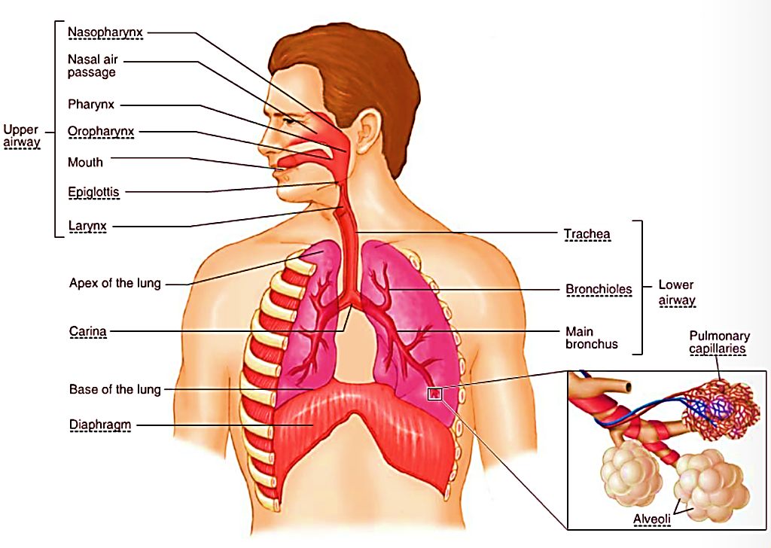
University of Basrah Al-zahraa medical college
Ministry of Higher Education and Scientific Research
Upper & lower respiratory tract:
LO2

Slide 6
University of Basrah Al-zahraa medical college
Ministry of Higher Education and Scientific Research
Upper respiratory tract:
All are conducting airway.
LO2
Lower respiratory tract:
The conducting airway(Conducting Zone):
  Trachea
  Bronchi
  Bronchioles
  Terminal bronchioles
Respiratory Zone
  Respiratory bronchioles
  Alveolar ducts
  Millions of alveoli
whose combined surface area totals about 70m2

Slide 7
University of Basrah Al-zahraa medical college
Ministry of Higher Education and Scientific Research
LO1
Functions of the upper respiratory tract:
A- Respiratory function
B- Non respiratory functions:
conducting air from atmosphere to the lower respiratory tract
conditioning (warming, humidification and trapping of particles) inspired air
protection of the airway during swallowing (larynx)
swallowing, (oropharynx & laryngopharynx)
smell (olfactory epithelium in nose)
speech (larynx)
Notes:
1-Protective function:
Particles <5µm in size can enter the lung and adhere to bronchial mucous which then expelled by cough reflex and cilia escalator action.
Cigarettes ??……. Bronchiectasis?? ……..
IgA, Neutrophils, Lymphocytes, and Alveolar Macrophages ??……
2- Acid-base balance …. pH normalization by CO2 level control.
3- Temperature regulations … heat loss by expiration.
4- Endocrine function ---Secretion of hormones like serotonin, and histamine…… Those are increased in Asthma and anaphylaxis.
5- Regulation of blood volume …. as the lung act as storage organ for blood

Slide 8
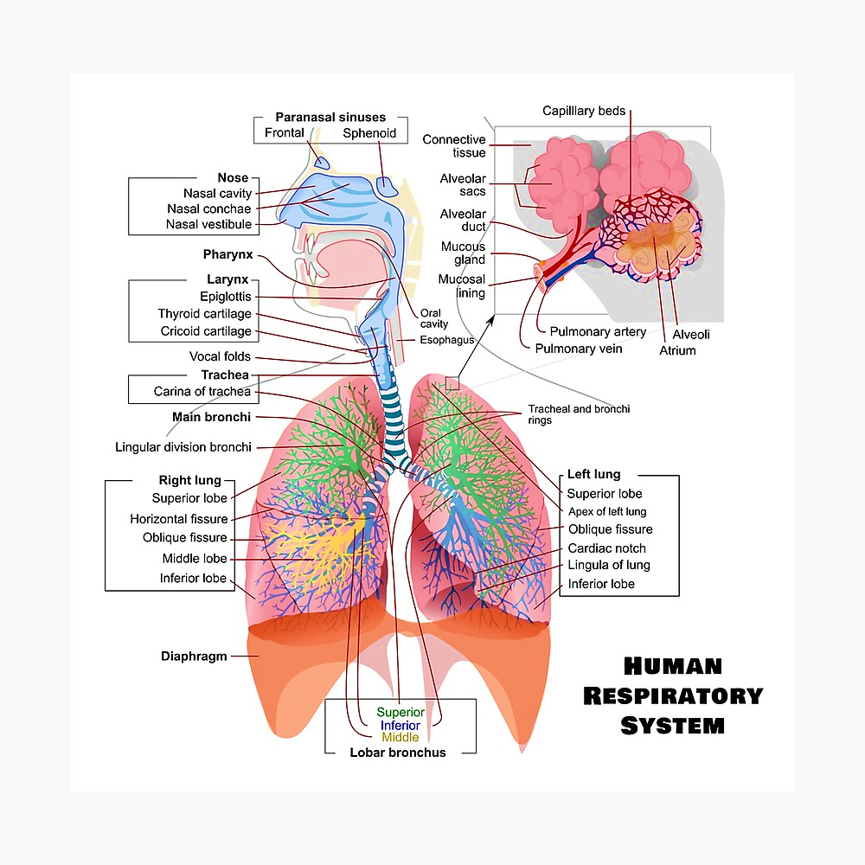
University of Basrah Al-zahraa medical college
Ministry of Higher Education and Scientific Research
LO2

Slide 9
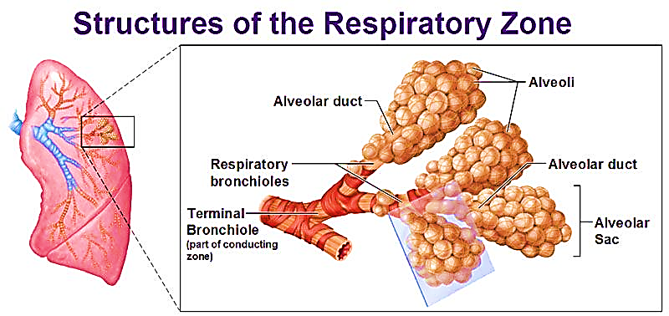
University of Basrah Al-zahraa medical college
Ministry of Higher Education and Scientific Research
LO2
Respiratory Zone:
Respiratory bronchioles, alveolar ducts and alveoli

Slide 10
University of Basrah Al-zahraa medical college
Ministry of Higher Education and Scientific Research
Appropriate Gaseous Environment
Physics of Gases
LO3
Boyle’s law: pressure is inversely proportional to volume.
Charles's law: pressure is proportional to absolute temperature. (i.e. kinetic energy of molecules increases with temperature)
The Universal Gas Law:
Pressure (P) is inversely proportional to volume (V) for a fixed quantity of gas and directly proportional to absolute temperature (T). P.V = nR.T
    P = gas pressure
    V = volume
    R = the universal gas constant
    n = the number of molecules of gas in moles
    T = temperature

Slide 11
University of Basrah Al-zahraa medical college
Ministry of Higher Education and Scientific Research
LO3
Pascal is the SI Unit of Pressure.
As this is small, in medicine kilopascals (kPa) are used.
1 kPa = 1000 Pa
Pressure is also expressed in mmHg
1 kPa = 7.5 mmHg,
1 mmHg = 0.133kPa
1 standard atmosphere (at sea level)
= 760 mmHg = 101.3 Kpa

Slide 12
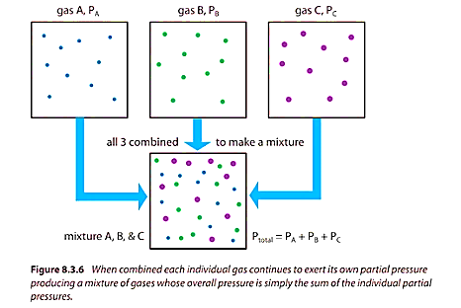
University of Basrah Al-zahraa medical college
Ministry of Higher Education and Scientific Research
LO3
Partial Pressure:
As the atmosphere is a mixture of gases the molecules of each type behave independently (do not combine chemically), so each gas exerts a partial pressure.

Slide 13
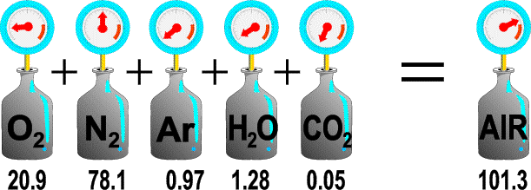
University of Basrah Al-zahraa medical college
Ministry of Higher Education and Scientific Research
LO3
Partial pressure (p): is the same proportion of the total pressure as the volume fraction of the gas in the mixture.
E.g. proportion of O2 in a dry atmospheric air is 20.9%, so if the total atmospheric air pressure is 101.1 kPa
pO2 = 101.1 x 0.209 = 21.1 kPa
(in mmHg pO2 = 760 x 0.209 = 158.9 mmHg)

Slide 14
University of Basrah Al-zahraa medical college
Ministry of Higher Education and Scientific Research
LO3
Water vapor:
Water vapor is a gas, exerting a vapor pressure.
The vapor pressure is maximum called the saturated vapor pressure (SVP) when the gas mixture is in equilibrium with water (generally the case in biological systems).
SVP depends only on temperature.
At 37°C the SVP of water is 6.28 kPa (47 mmHg), and is independent of total pressure.
Therefore: for air saturated with water at 37°C,
pO2 = (101.1 - 6.28) x 0.209 = 19.8 kPa
Dry air pO2 = 101.1 x 0.209 = 21.1 kPa

Slide 15
University of Basrah Al-zahraa medical college
Ministry of Higher Education and Scientific Research
Effect of Temperature and Humidity
LO3
The relative O2 concentration decreases as the relative humidity increases
This decrease is more as the temperature increases

Slide 16
University of Basrah Al-zahraa medical college
Ministry of Higher Education and Scientific Research
Gases in water:
LO3
Gas mixture is in contact with water
Gas molecules will dissolve in the liquid
Until equilibrium is established between rate of solution and dissolution of gas
At equilibrium, gases exert a partial pressure or tension in the liquid, which is equal to their partial pressures in the gas phase

Slide 17
University of Basrah Al-zahraa medical college
Ministry of Higher Education and Scientific Research
Gases in water:
The partial pressure of a gas, in a liquid, is a measure of its tendency to escape from the liquid and not a measure of the content of gas in the liquid.
LO3
Content is determined by solubility of gas in the liquid.

Slide 18
University of Basrah Al-zahraa medical college
Ministry of Higher Education and Scientific Research
LO3
Solubility of Gases:
*Is the number of mmol of gas that will dissolve in a liter of water, at a given partial pressure, The units of solubility are mmol/Litre/kPa. Solubility is a Constant for that gas.
The amount of a gas dissolved in plasma = solubility of that gas x its partial pressure.
* If the partial pressure of the gas increases, more will dissolve.
*The solubility of oxygen in plasma at 37°C (body temp) is known as the coefficient of solubility of O2 = 0.01 mmol/Litre/kPa
*The coefficient of solubility of CO2 = 0.23 mmol/Litre/kPa
**CO2 is 23 times more soluble in plasma than oxygen.

Slide 19
University of Basrah Al-zahraa medical college
Ministry of Higher Education and Scientific Research
LO3
Example:
*When plasma is equilibrated with air having a partial pressure of Oxygen (pO2) of 13.3 kPa (100 mmHg):
*Solubility coefficient of Oxygen is 0.01mmol/L/kPa at 37°C.
*The plasma O2 content will be:
13.3 x 0.01 = 0.13mmol per liter

Slide 20
University of Basrah Al-zahraa medical college
Ministry of Higher Education and Scientific Research
LO3
Example:
*When whole blood is equilibrated with a pO2 of 13.3 kPa:
*Tension will still be 13.3 kPa.
*Content will rise to 8.75 mmol/liter.
Due to haemoglobin (Hb) in whole blood binds large amounts of Oxygen.
Thus the content reflects the amount dissolved in plasma + the amount bound to Hb.

Slide 21
University of Basrah Al-zahraa medical college
Ministry of Higher Education and Scientific Research
The Pulmonary Circulation:
LO3
 | mm Hg
The pulmonary arterial pressure is typically | 14 - 18 mm Hg (mean) systolic: 20-25 / diastolic: 4-12
The hydrostatic pressure in pulmonary capillaries is typically | 9 mm Hg
The pressure in the pulmonary veins/left atrium is typically | 1 - 10 mm Hg

Slide 22
University of Basrah Al-zahraa medical college
Ministry of Higher Education and Scientific Research
LO3
The pulmonary circulation is a Low pressure
The pulmonary circulation is a low resistance system 'supply driven' unlike the systemic circulation 'demand-led’. (Receives entire cardiac output)
Pulmonary low resistance vessels do not influence the total flow through the pulmonary circulation, only the distribution of blood within it.
Forms practically no tissue fluid
Regional blood flow ‘matched’ to air supply (‘ventilation’) by local vasoconstriction when pO2 is low

Slide 23
University of Basrah Al-zahraa medical college
Ministry of Higher Education and Scientific Research
The hydrostatic pressure gradient = Capillary hydrostatic Pressure - Interstitial space hydrostatic Pressure.
LO3
The oncotic pressure gradient = Capillary oncotic Pressure - Interstitial space oncotic Pressure.
Hydrostatic pressure gradient X Oncotic pressure gradient
Drives fluid from the pulmonary microcirculation into the interstitium.
Drives fluid from the interstitium into the pulmonary microcirculation.
In the normal lung, oncotic pressure tending to draw fluid back into the circulation is always greater than hydrostatic pressure tending to force it out

Slide 24
University of Basrah Al-zahraa medical college
Ministry of Higher Education and Scientific Research
LO3
Any disturbance in the starling forces operating in the pulmonary circulation can lead to an accumulation of fluid in the alveoli, impairing gas exchange, and causing respiratory distress
Capillary hydrostatic pressure in the normal pulmonary circulation is always less than the colloid osmotic pressure.
So tissue fluid is not normally formed, except occasionally in the base of the lungs where the effects of gravity increase transmural hydrostatic pressure

Slide 25
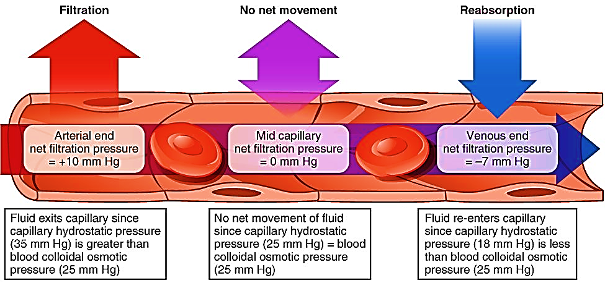
University of Basrah Al-zahraa medical college
Ministry of Higher Education and Scientific Research
LO3
In systemic capillaries:

Slide 26
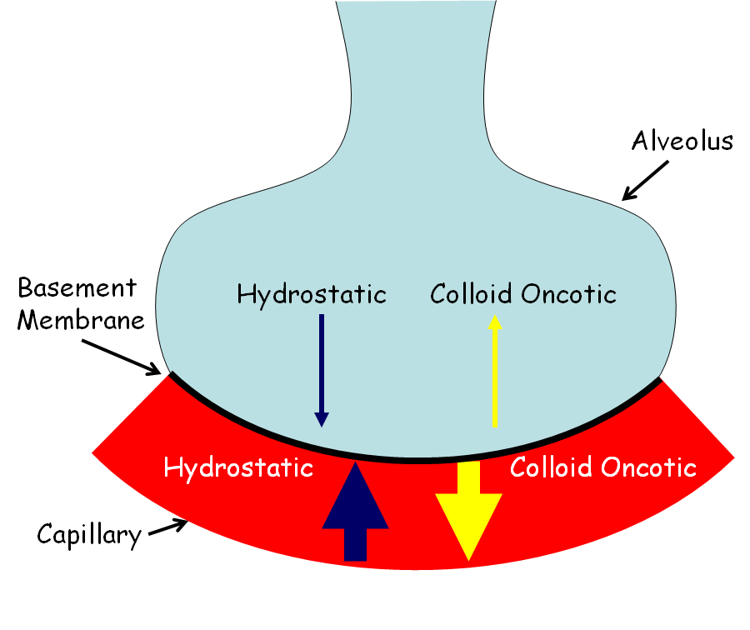
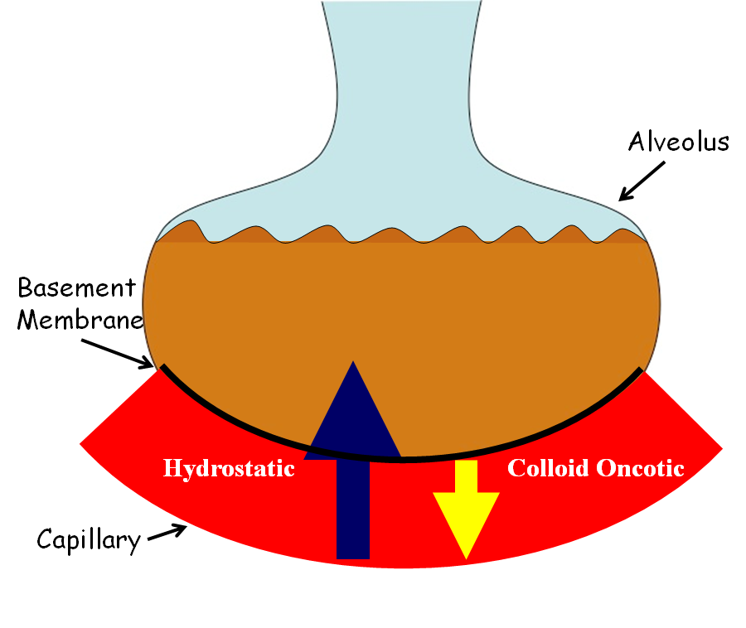
University of Basrah Al-zahraa medical college
Ministry of Higher Education and Scientific Research
In pulmonary capillaries:
LO3
Normal
Pulmonary edema

Slide 27
University of Basrah Al-zahraa medical college
Ministry of Higher Education and Scientific Research
LO4
Pulmonary ventilation or breathing:
Is the exchange of air between the atmosphere and the lungs.
Air moves from a region of high air pressure to region of low air pressure.
  Air in …. Inspiration
  Air out …. Expiration

Slide 28
University of Basrah Al-zahraa medical college
Ministry of Higher Education and Scientific Research
LO4
Tidal Volume [TV]: air that moves into and out of the lungs with each breath, approximately 500ml.
The respiratory rate: is the rate at which breathing occurs; it is set and controlled by the respiratory center of the brain. A person's respiratory rate is usually measured in breaths per minute.
Normal adult respiratory rate [RR] is 12-16 breath/min
Alveolar ventilation rate is less than pulmonary ventilation rate
pulmonary minute ventilation= (tidal volume × RR) or (500 mL × 12 breaths/min) = 6000 mL/min.
Alveolar ventilation rate = ([tidal volume − dead space] × RR) ([500 mL − 150 mL] × 12 breaths/min) = 4200 mL/min.

Slide 29
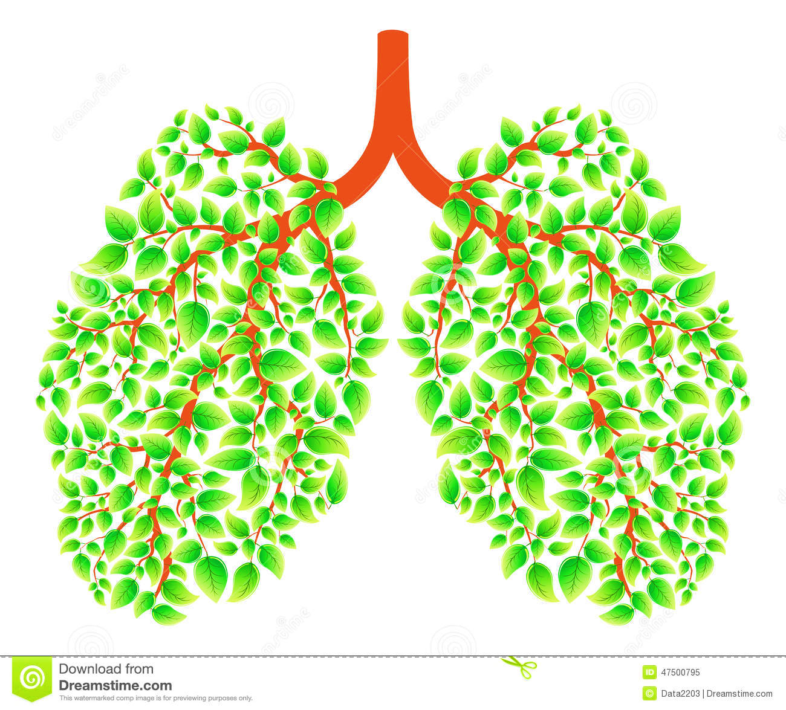
University of Basrah Al-zahraa medical college
Ministry of Higher Education and Scientific Research
THANK YOU

